Slide 1
Term Project, Algorithms 2018 Intersection Manager
王威翔 alg1753
李尚軒 alg1752
指導教授:江蕙如 教授

Slide 2
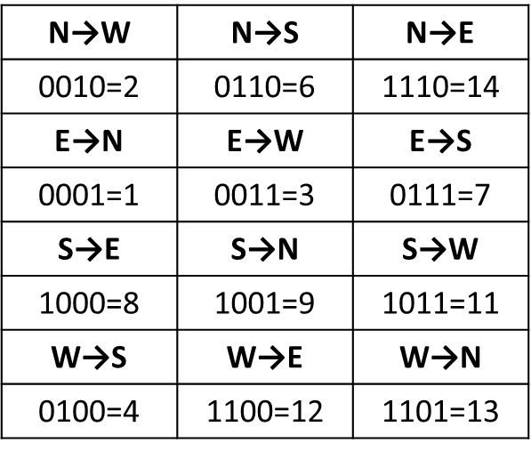
Basic Rules
Slice the intersection
Represents each direction with a binary number
Bitwise operation in C++
 | 2 | 1
 | 3 | 4
e.g.
x & y == 0: match
match
W→S = 0100
S→W = 1011

Slide 3
Rate each car
Within a adjustable range, rate each car by the cars that can pass simultaneously
Matching rating
Distance rating
Rating of previous car
(each rating has its adjustable weight)
N: |  | 234 |  |  | 23 | 234
E: |  | 123 | 123 | 1 |  |  | 12
S: | 14 | 4 | 124 | 124 | 14 | 4 | 124
W: | 134 | 34 | 3 |  |  | 134 |  | 34

Slide 4
Choose the car(s) depart at each round
Start with time=0:
Make more cars depart simultaneously as possible
If multiple choice, choose by (a) earlier arrive time and (b) higher rating
Input 3
Rating (range = -4~3, weight={1,0.2,0.25})
N: | 234 |  | 234 |  | 23 | 234
E: |  | 123 | 123 | 123 | 1 |  | 12
S: | 4 | 4 | 4 | 4 |  | 4 | 124
W: | 34 | 34 |  |  | 34 | 134 |  | 34
N: | 0.34 | 1.35 | 5.38 | 3.94 | 15.75 | 4.6 | 0 | 0
E: | 6.48 | 25.91 | 30.03 | 29.72 | 29.29 | 3.95 | 15.8 | 0
S: | 18.72 | 22.07 | 22.27 | 20.67 | 4.68 | 18.7 | 0 | 0
W: | 0.58 | 2.31 | 0.46 | 1.83 | 7.31 | 0.43 | 1.7 | 6.8
Result
N: |  |  |  |  | 234 |  |  | 234 | 23 |  | 234
E: |  | 123 | 123 | 123 | 1 |  | 12
S: | 4 | 4 | 4 | 4 |  |  |  |  | 4 |  |  |  | 124
W: |  |  |  |  |  | 34 | 34 |  |  | 34 |  | 134 |  | 34

Slide 5
Adjusting variables to produce new solver
Different values of variables:
Range{begin, end}
Weighting{matching rating, distance rating, predecessor rating }
Run all the choices assigned and derive the best answer

Slide 6
Result
Input | Result | Optimal announced
1 | 0.67 | 0.67
2 | 3.63 | <3.158
3 | 2.7 | 2.5~2.75
4 | 3.375 | 2.5~2.8
5 | 3.15 | 3~3.25

